Slide 1


YoloMask: A Deep Learning Based Face Mask Detector
Don-Joshua Argomido
Undergraduate Student
Department of Computer Science
Eric Chien
Undergraduate Student
Department of Computer Science
Spring 2021
Notes:
Machine Learning is the science (and art) of programming computers so they can learn from data.

Slide 2





MUSE Committee
Dr. Deborah Dunn
Dr. Jeremy Becnel
Dr. Timothy Nix
Mentor
Dr. Dipak Singh

Slide 3
Overview
Introduction
Background
Related Work
Methodology
Dataset Collection
Data Preprocessing
Object Classification
Object Detection
Results
Future Work

Slide 4
Introduction

Slide 5
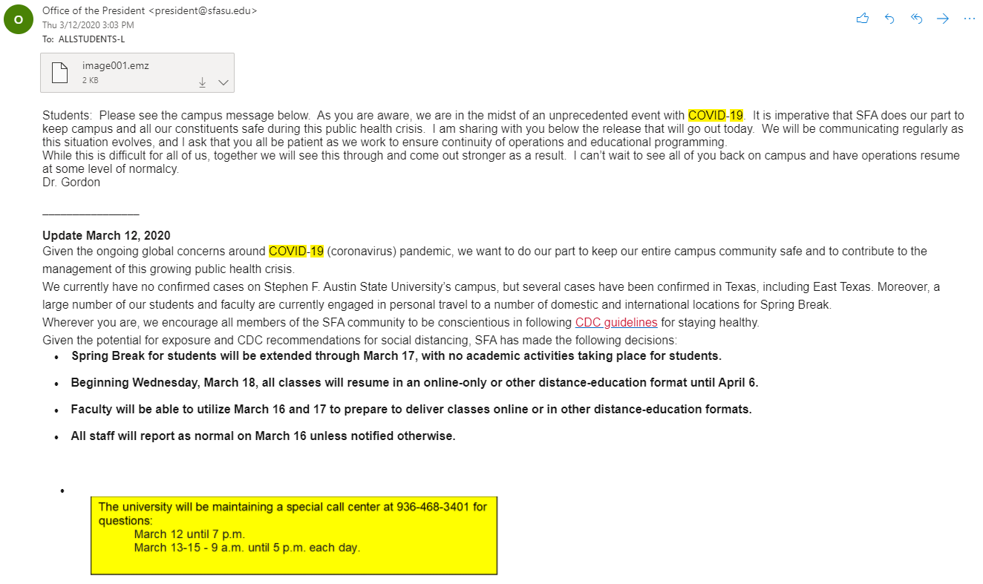
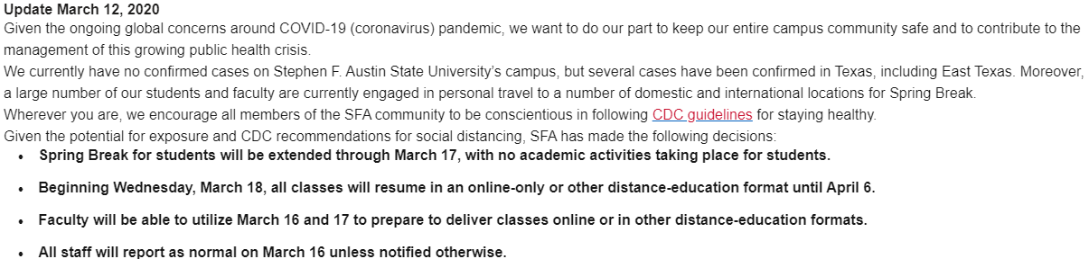
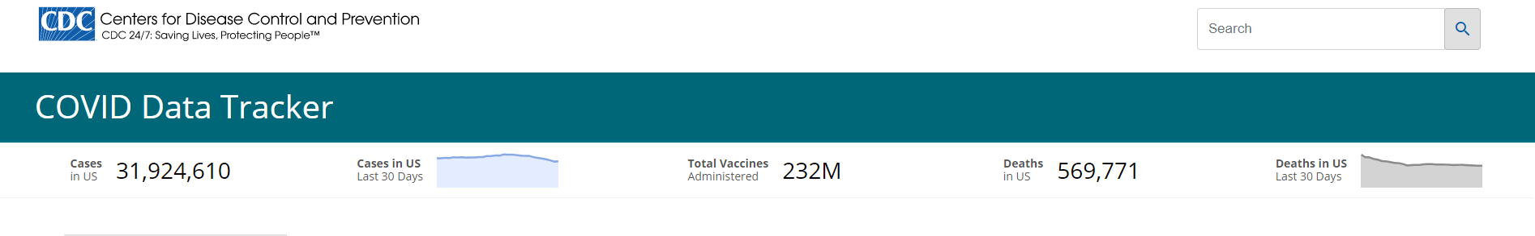
Why Face Mask?
Due to COVID-19 face mask has been an obvious lifestyle change.
As of 4/27/2021
Notes:
Fix image quality
Crop COVID Data Tracker
Say why we are doing this research, email from president.

Slide 6
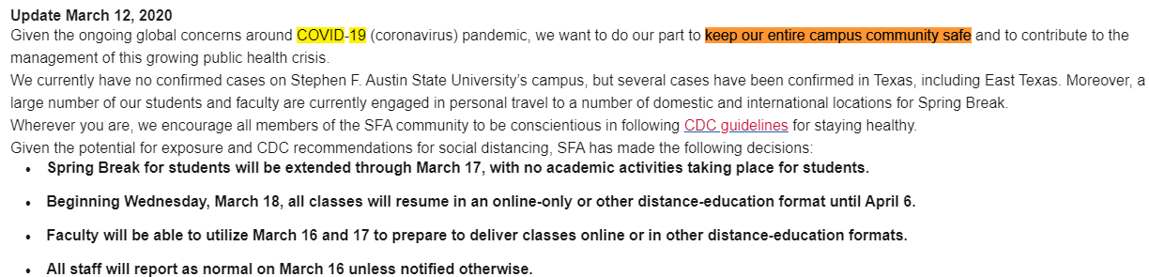
Why Face Mask?
Due to COVID-19 face mask has been an obvious lifestyle change.
As of 4/27/2021
Notes:
Wearing mask prevent the spread of the virus. Result Pres Gordon implemented CDC guidelines. He ask to keep the community safe.Contribute towards the community. Facemask detection would recognise if a person would wear a mask. Help in extracurricular events as well as the classroom setting. Reminder to wear mask.

Slide 7
Background

Slide 8
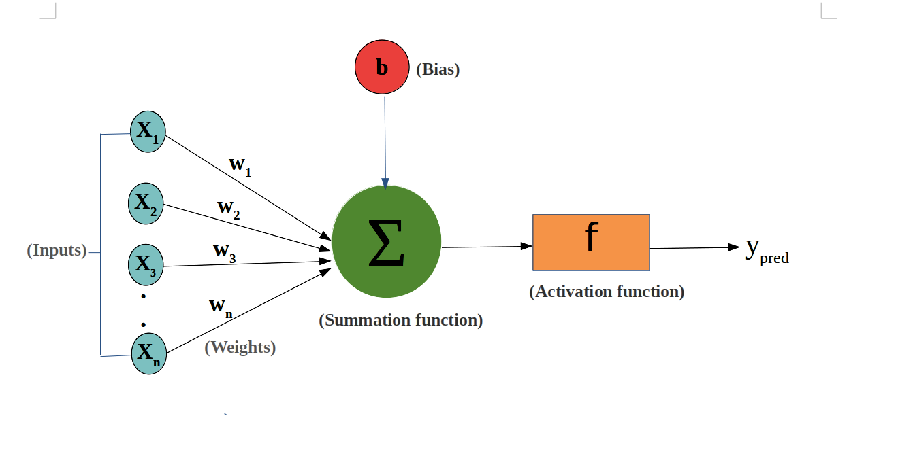
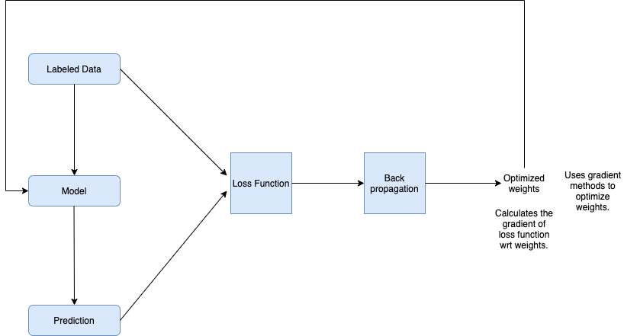

Neural Network
Notes:
Add colors, Make fonts bigger, Make the model horizontal

Slide 9

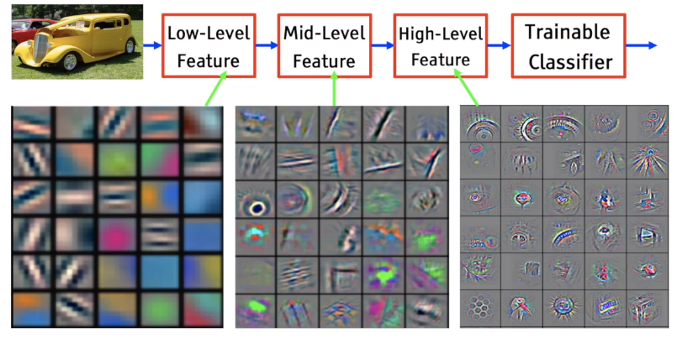
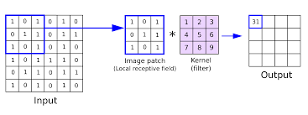
Convolutional Neural Network

Slide 10
Related Work

Slide 11
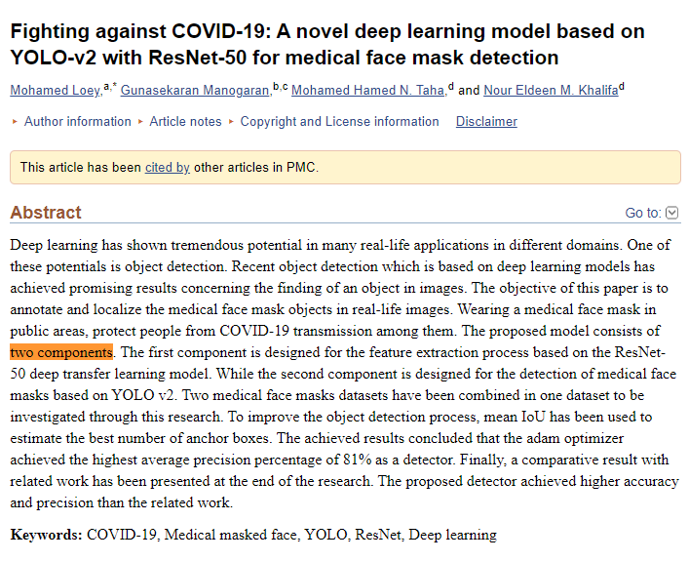
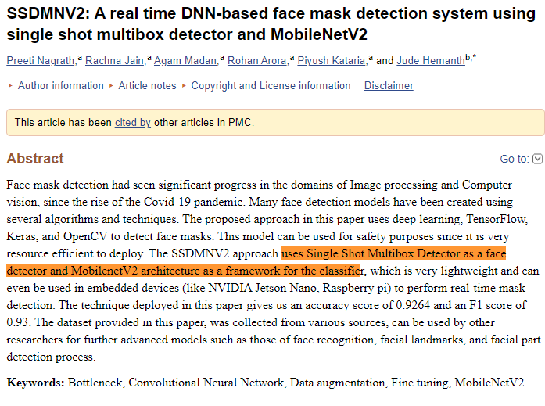
Deep learning based models
Notes:
Related work: these work has been done, we are not the first.
Two-stage detection model
-detect the face
-then mask
Move the disadvantage after this slide

Slide 12
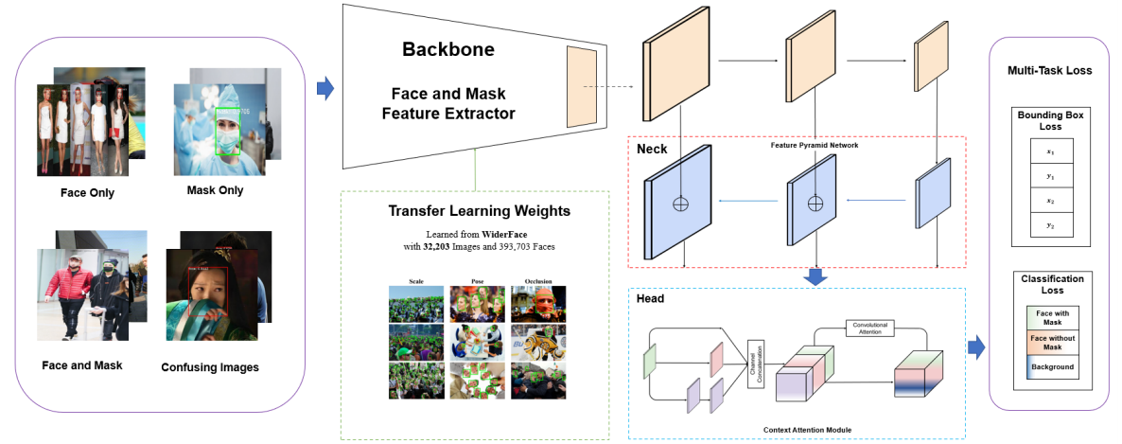
Disadvantages
Two-stage detector - longer time for inference
Complex face detection model - longer training time
Alternative: YOLOv4
Single-stage detector
Notes:
Fix image quality
Object Recognition detects whether an object has a mask or not.
The problem is that if there are multiple people who has mask or no mask it will have trouble.

Slide 13
Methodology

Slide 14
Dataset Collection
Table 1.1: Face Mask Dataset Statistics
Kaggle Dataset: | # Images | Mask/No Mask/Both
Dataset 1 (with annotations) | 853 | Both
Dataset 2 | 329 | Mask
 | 131 | No Mask
Dataset 3 | 656 | Mask
 | 956 | No Mask
Dataset 4 | 5883 | Mask
 | 5909 | No Mask
Dataset 5 | 3725 | Mask
 | 3828 | No Mask
SFA Dataset: | # Images | Mask/No Mask or both
Dataset 6 (with annotations) | 81 | Both

Slide 15
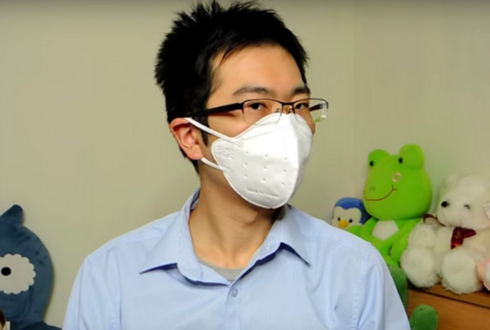
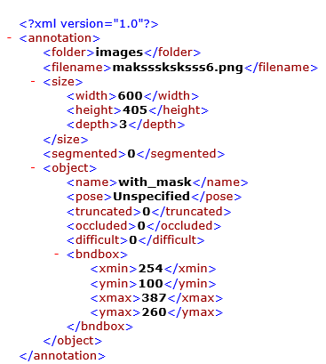
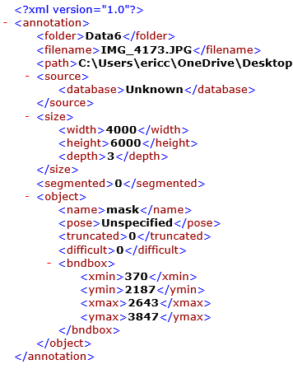
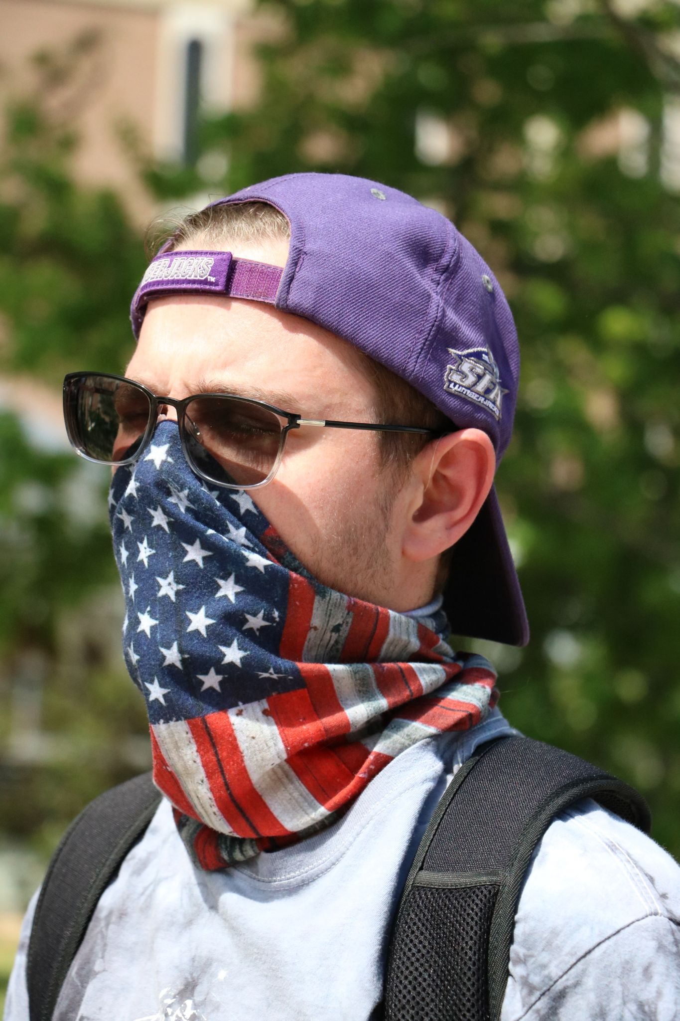
Dataset Examples
Dataset 1
(with annotations)
SFA Dataset
(with annotation)

Slide 16
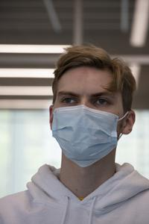
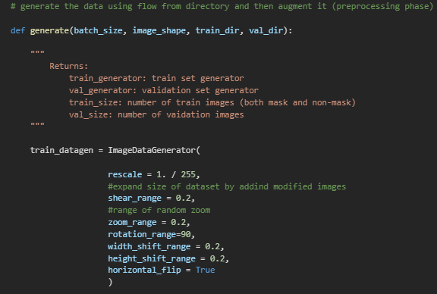
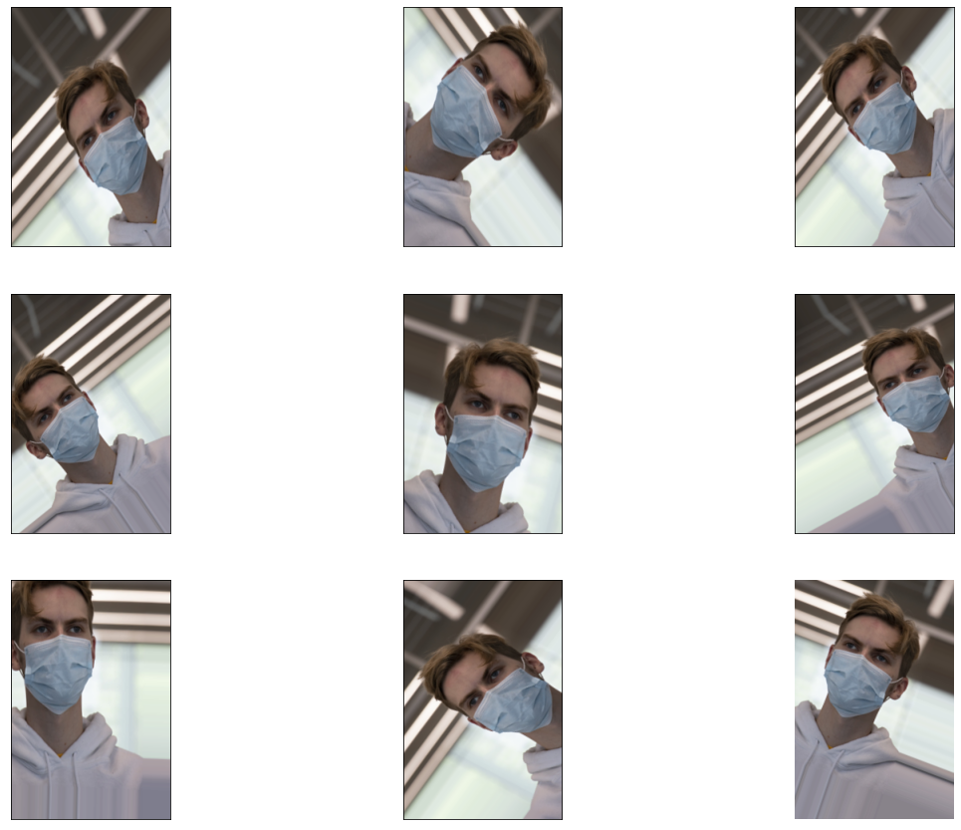
Data Preprocessing

Slide 17
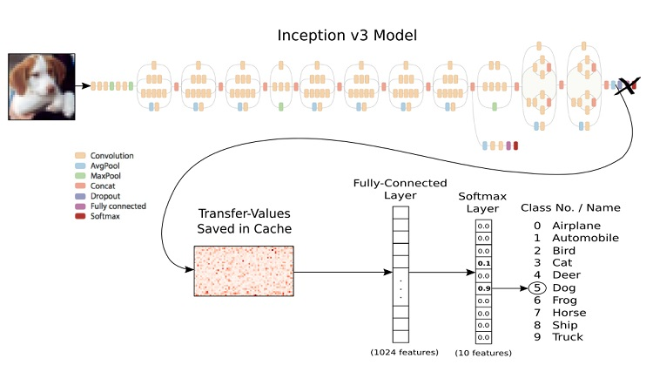
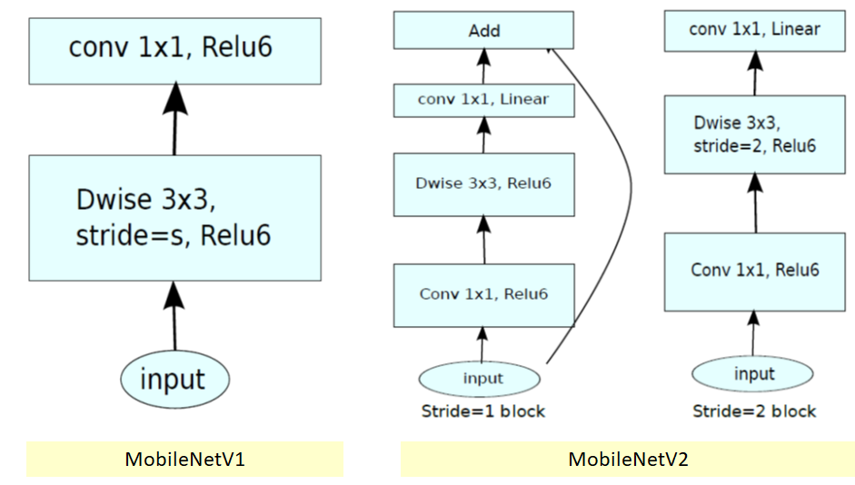
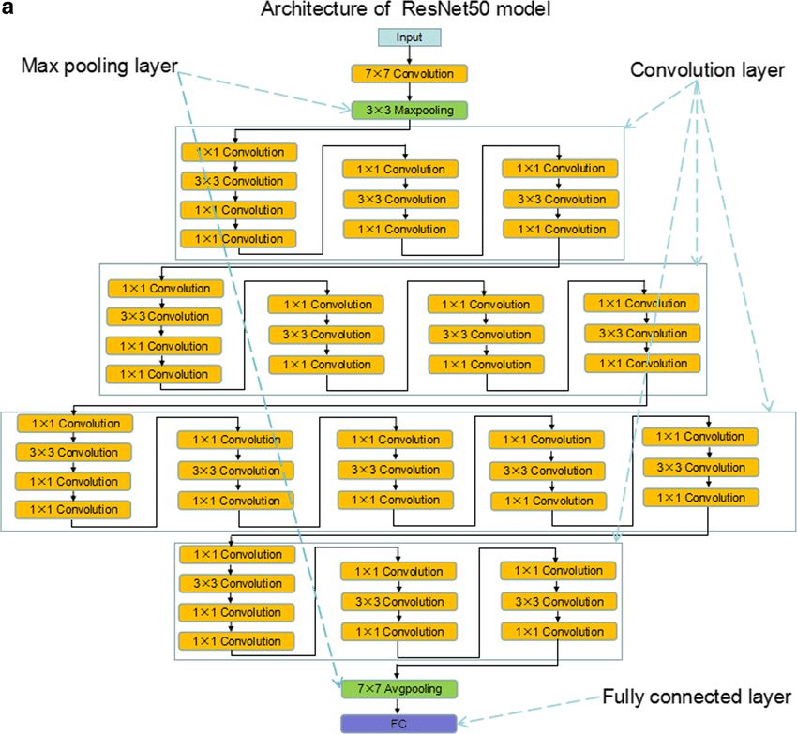
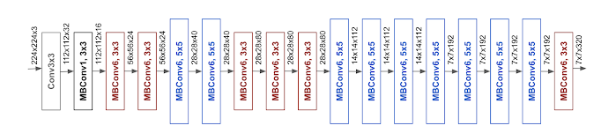
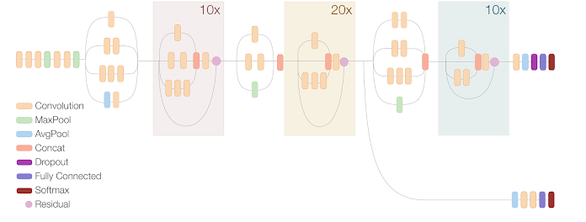
Model Selection for Object Classification
MobileNet
Inceptionv3
ResNet50
EfficientNet
InceptionResNet2
Notes:
Fix ResNet Image
Model selection
Why we went through this model?
It performs the best on image classification projects.

Slide 18
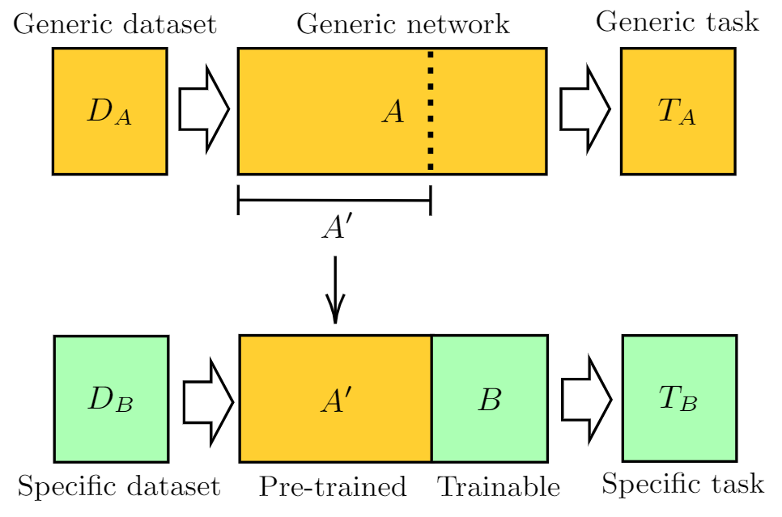
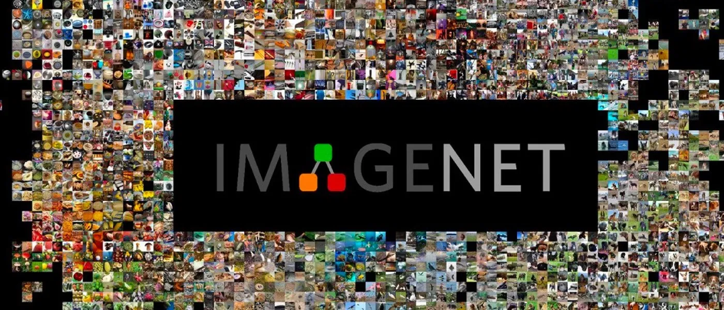
Transfer Learning
14 million image, 20,000 classes
Advantages:
Overcome limitation of dataset
Faster training
Notes:
Transfer Learning due to small dataset
Transfer learning is where a model that is already pretrained is repurpose for another specific dataset using imagenet weights.
Give examples

Slide 19
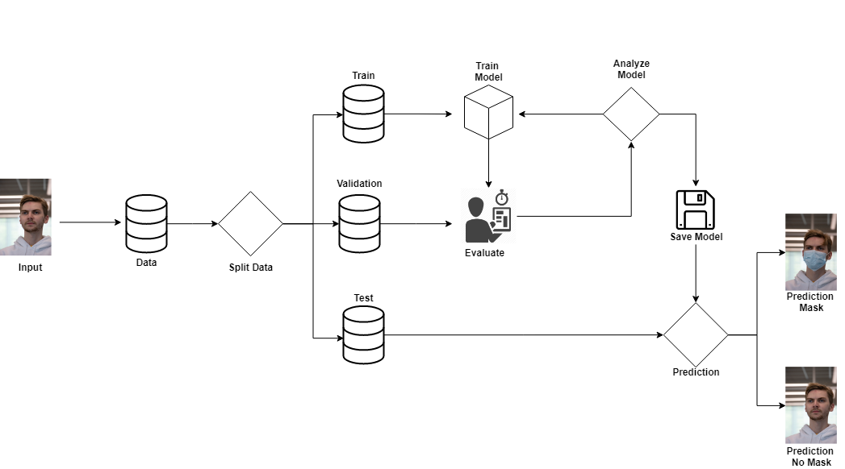
Face Mask Classification Pipeline
Train Models
Run Model
Data Collecting and Processing
Fig: FaceMask classification pipeline
Notes:
Implement fig similar to YOLO except saying mask or no mask
Train on train data not validation

Slide 20


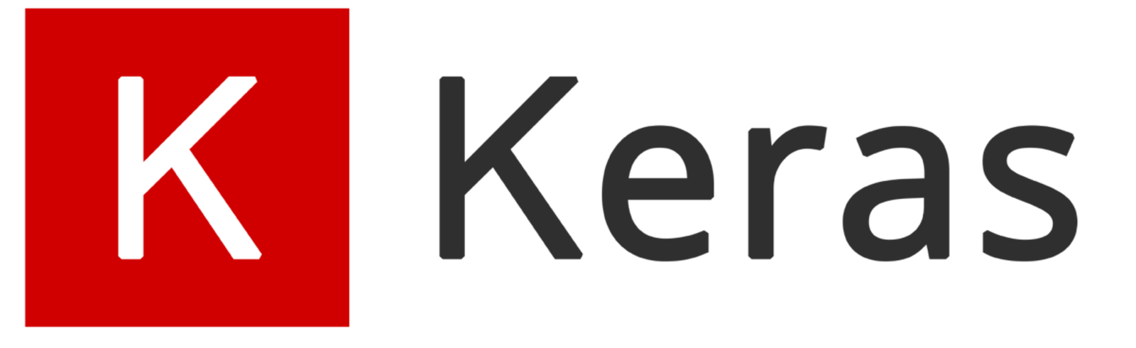
Experimental Setup
GPU: Nvidia Tesla P100/GTX 1080/RTX 2070 Super
Hours: 2
ML tools: Tensorflow Keras
Platform: Google Colab, Jupyter Notebook
Epoch:30
Hyperparameters: learning rate = 0.001, batch_size=32
Optimizer function: Adam
Notes:
Crop keras
Create table for Experimental Setup

Slide 21
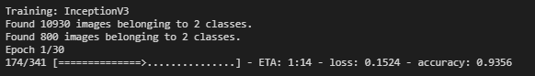
Results for Object Classification
Model Name | Test Accuracy
InceptionV3 | W/O TL: 0.9965
 | W TL: 0.998
ResNet50 | W/O TL: 0.9975
 | W TL: 0.9965
MobilenetV2 | W/O TL: 0.9989
 | W TL: 0.9876
Inception ResNetV2 | W/O TL: 0.998
 | W TL: 0.9975
Efficient NetB2 | W/O TL: 0.9999
 | W TL: 0.9989
Notes:
Only Test

Slide 22
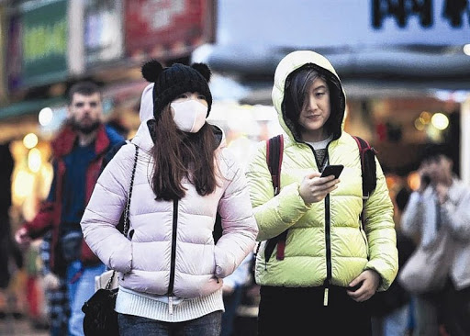
Disadvantage of Object Classification
If there are multiple images with mask or without mask it will have trouble detecting it.
No Mask
Notes:
Only Test

Slide 23
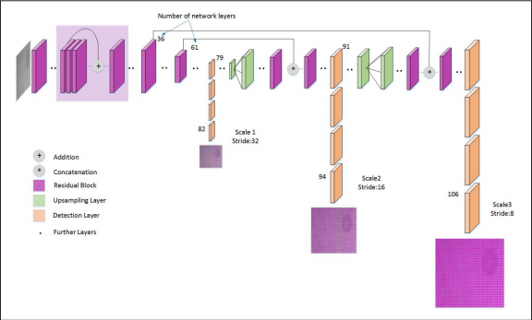
Object Detection: Yolov4
Table: Yolov4 Model Hyperparameters
#Training
batch= 64
subdivision= 16
width= 416
height= 416
channels= 3
momentum= 0.949
decay= 0.0005
angle= 0
saturation= 1.5
exposure= 1.5
hue= .1
[convolutional]
batch_normalize= 1
filters= 64
size= 3
stride= 2
pad= 1
activation= mish
[convolutional]
batch_normalize= 1
filters= 64
size= 1
stride= 1
Fig: Yolov4 Architecture
Notes:
YOLv4 (You Only Look Once) is an object detection algorithm that create a bounding box around the object.
The neural network divides the image into multiple regions, while predicting the bounding box and probabilities in each region.
The model uses the pre-trained ImageNet weights that contains thousands of classes.
YOLOv4 measures accuracy through uses the mean average precision and intersection over union*.
Image Quaility
Fix images
Write the hyperparameters into a table
Re

Slide 24
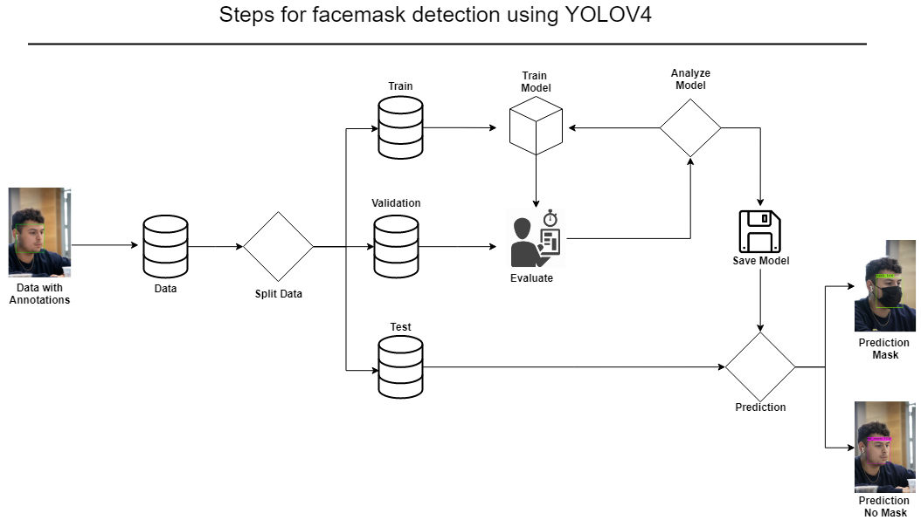
Face Mask Detection Pipeline
Fig: Face Mask Detection Pipeline using YOLOv4
Notes:
Steps for object detection:
Object detection is a computer vision technique for locating instance of objects in images or videos.
In our case we used YOLOv4 for detecting our model:
So first we grab the annotations of the images. The annotations has coordinates of where the real bounding boxes are.
We then split the data intro three folders train,val,test and we feed train inside our model to train

Slide 25
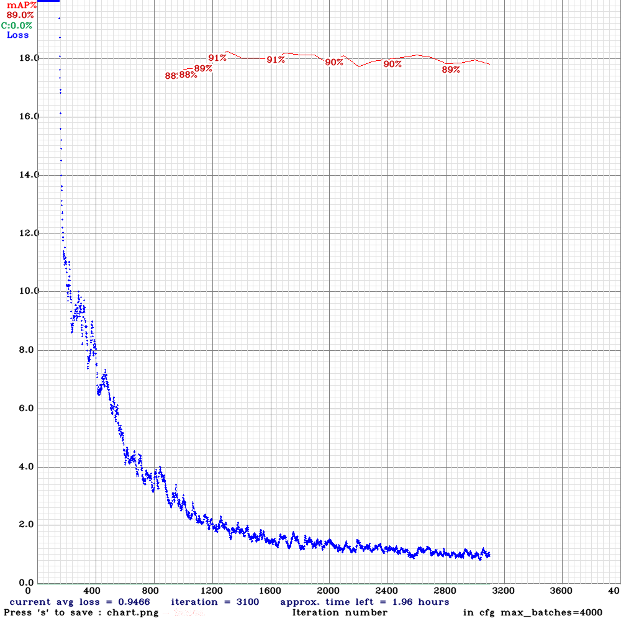
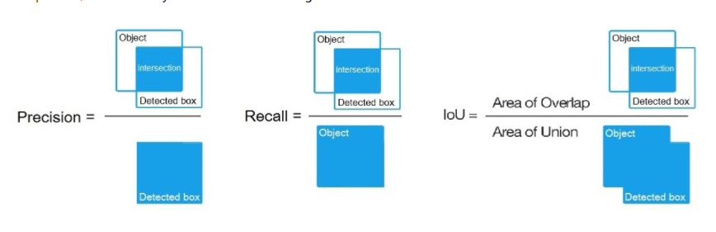
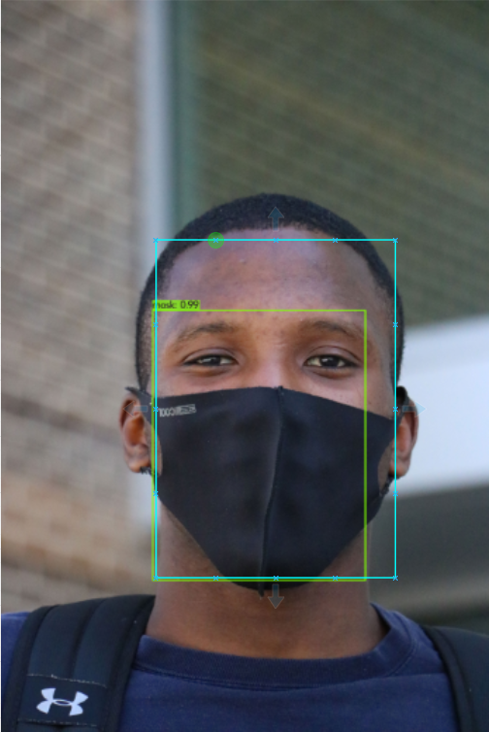
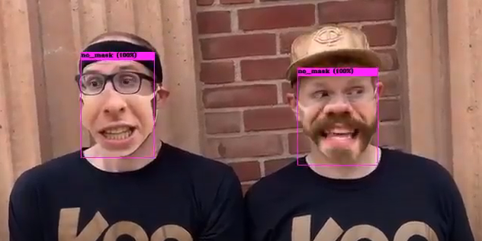
YOLOv4 Results
Loss\mAP
Iterations
Fig: YOLOv4 loss and mAP graph
Notes:
IoU(Intersection of Union)- Intersection over Union is an evaluation metric used to measure the accuracy of an object detector on a particular dataset.
mAP(mean Average Precision)-Mean Average Precision is a mathematical equation where it sees how precise a model is. By seeing the True positive divided by the True positive plus the false positive.
Know what the difference between precision and Recall
mAP looking for precision not recall.
Inability of the model.

Slide 26
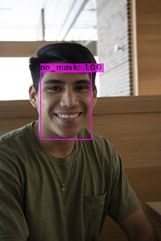
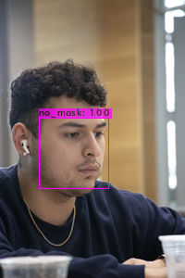
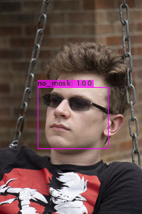
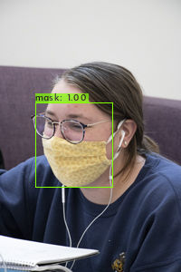
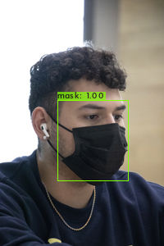
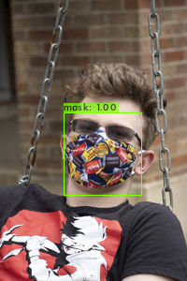
Image result of SFA students
Notes:
Align images

Slide 27
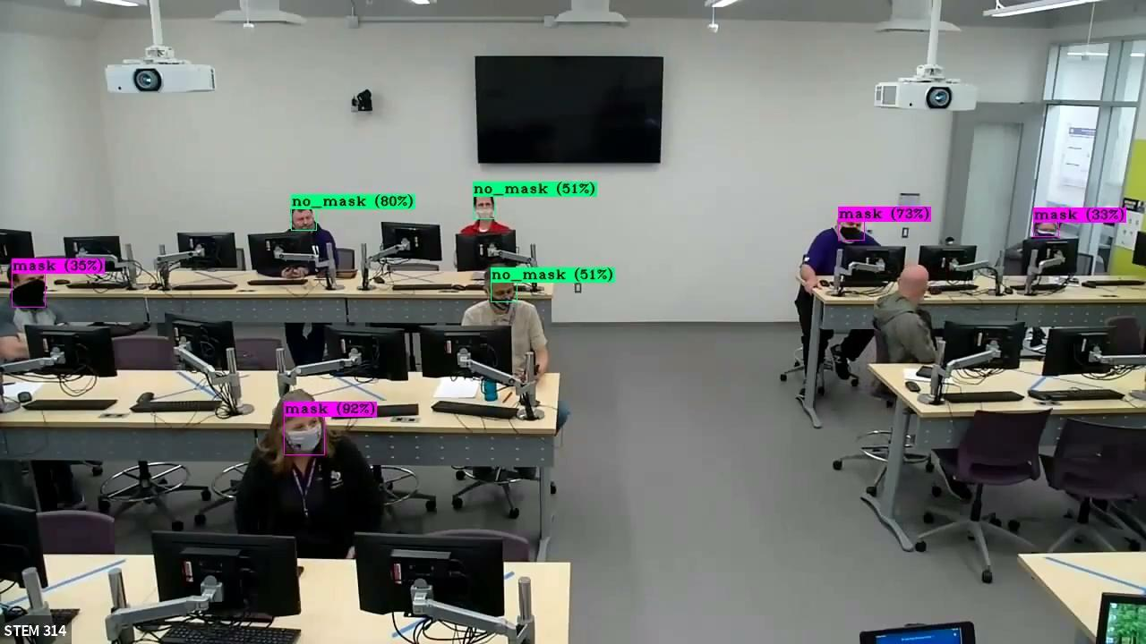
Notes:
Crop video start from 1:00-2:30
-Highlight Dr.Long
-Dr.Beaurgard cannot detect mask due to the background

Slide 28
Future work
Object detection and recognition
Deploy deep learning models in medical dataset such as X-rays
Notes:
Future work: Work on developing a deep learning model that can identify people and their names
Work on developing a model that can recognized different bone fractures.

Slide 29
References
“COVID-19 Provisional Counts - Weekly Updates by Select Demographic and Geographic Characteristics.” Centers for Disease Control and Prevention, Centers for Disease Control and Prevention, 21 Apr. 2021, www.cdc.gov/nchs/nvss/vsrr/covid_weekly/index.htm.
M;, Cucinotta D;Vanelli. “WHO Declares COVID-19 a Pandemic.” Acta Bio-Medica : Atenei Parmensis, U.S. National Library of Medicine, pubmed.ncbi.nlm.nih.gov/32191675/ .
“Provisional Death Counts for Coronavirus Disease 2019 (COVID-19).” Centers for Disease Control and Prevention, Centers for Disease Control and Prevention, 27 Apr. 2021, www.cdc.gov/nchs/nvss/vsrr/covid19/index.htm.
“Still Confused About Masks? Here's the Science Behind How Face Masks Prevent Coronavirus.” Still Confused About Masks? Here's the Science Behind How Face Masks Prevent Coronavirus | UC San Francisco, 22 Apr. 2021, www.ucsf.edu/news/2020/06/417906/still-confused-about-masks-heres-science-behind-how-face-masks-prevent.
Nagrath, Preeti, et al. “SSDMNV2: A Real Time DNN-Based Face Mask Detection System Using Single Shot Multibox Detector and MobileNetV2.” Sustainable Cities and Society, Elsevier Ltd., Mar. 2021, www.ncbi.nlm.nih.gov/pmc/articles/PMC7775036/ .
Jiang, Mingjie, et al. “RetinaFaceMask: A Face Mask Detector.” University of Hong Kong, 9 June 2020.
Brownlee, Jason. “A Gentle Introduction to Object Recognition With Deep Learning.” Machine Learning Mastery, 26 Jan. 2021, machinelearningmastery.com/object-recognition-with-deep-learning/.
ImageNet, www.image-net.org/index.
Hui, Jonathan. “MAP (Mean Average Precision) for Object Detection.” Medium, Medium, 3 Apr. 2019, jonathan-hui.medium.com/map-mean-average-precision-for-object-detection-45c121a31173.

Slide 30
Questions?

